Slide 1

Software Testing
By: Anand C Unakal

Slide 2

Introduction
Software: Set of instructions or data a computer processor reads in order to perform a task or operation.
There are 2 types of software's: Application and System.
System software: Are programs that are dedicated to managing the computer itself. Example: Operating system.
Application software: Is a computer program designed to perform a group of coordinated functions, tasks, or activities for the benefit of the user.
Notes:
2

Slide 3
Software Testing
Examples: Word processor, spreadsheet, web browser or media player.
Software testing is an activity to check whether the actual results match the expected results and to ensure that the software system is defect free.

Slide 4
Principles of Testing
Goal of testing is to find defects before customers find them.
Exhaustive testing is not possible. Testing can show presence of defects but not absence.
Testing is involved through out the software development life cycle.
Understand the reason behind testing.
Test the tests first. It means check the main functionality first for which you have written the test cases.

Slide 5
Principles of Testing
Tests develop immunity and have to be revised constantly. Means testing protects from defects that are present.
Defects occurs in clusters and testing should focus on these clusters.
Testing helps in defect prevention.
Testing is a fine balance of defect prevention and defect detection.
Intelligent and well planned automation is key to realizing the benefits of testing.
Testing requires talented, committed people who believe in themselves and work in teams.

Slide 6
SDLC-Software development life cycle
Requirement, gathering and Analysis
Planning
Design
Development or coding
Testing
Deployment and
Maintenance.

Slide 7
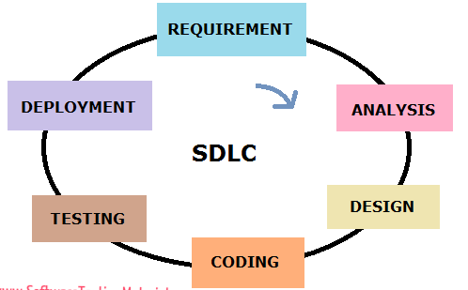
SDLC-Software development life cycle

Slide 8
1.Requirements gathering and Analysis
During this phase the specific requirements of the software to be built are gathered and documented.
The requirements get documented in the form of a System Requirement Specification(SRS) document.
This document acts as a bridge between the customer and the designers to build the product.

Slide 9
2. Planning
The purpose of the planning is to come up with a schedule, the scope and resource requirements for a release.
A plan explains how the requirements will be met and by which time.
It needs to take into account the requirements what will be met and what will not be met for current release to decide on the scope for the project.

Slide 10
3. Design
The purpose of the design phase is to figure out how to satisfy the requirements mentioned in the SRS.
Based on the documented requirements, the product architects create the optimal product design, minimizing the risks and taking into account budget and time constraints.
4. Development or coding
At this stage, the product is created based on the previously agreed design.
This development or coding phase comprises coding the programs in the chosen programming language.

Slide 11
5. Testing
The created product is tested, and any issues are reported, documented, fixed and tested again. This process follows until the product quality requirements are met.
6. Deployment and maintenance
Once the product is tested, it is given to the customers who deploy it in their environments. As the users start using the product in their environments, they may observe any differences in the actual and expected results.
The product now enters the maintenance phase, wherein the product is changed to satisfy the changes that arise from the customers expectations..

Slide 12
Quality ,Quality Assurance
Quality is meeting the requirements expected of the software, consistently and predictably.
Quality assurance attempts defect prevention by concentrating on the process of producing the product rather than working on defect detection/correction after the product is built.

Slide 13
Quality Control
Quality control attempts to build a product, test it for expected behavior after it is built and if the expected behavior is not the same as the actual behavior of the product, fixes the product as it necessary and rebuilds the product.

Slide 14
Difference between quality assurance and Quality control
Quality Assurance | Quality Control
Concentrates on the process of producing the product. | Concentrates on specific products.
Defect prevention oriented. | Defect detection and correction oriented.
Usually done throughout the life cycle. | Usually done after the product is built.
This is usually a staff function | This is usually a line function.
Examples: Reviews and audits | Examples: Software testing at various levels

Slide 15
Testing, Verification and Validation
Software testing is an activity to check whether the actual results match the expected results and to ensure that the software system is Defect free.
Verification is the process of evaluating a system of component to determine whether the products of the given phase satisfy the conditions imposed at the start of that phase.
It includes reviews and meetings, inspection, etc. to evaluate documents, plans, code, requirements and specifications.

Slide 16
Validation is the process of evaluating a system or component during or at the end of the development process to determine whether it satisfies specified requirements.
Verification -Focuses on question “Are we building the product right?”
Validation -Focuses on question “Are we building the right product?”
Quality Assurance = Verification
Quality Control = Validation
= Testing
Validation

Slide 17
Life cycle models
Different types of life cycle models are:
Waterfall model.
Prototyping and rapid application development model.
Spiral or Iterative model.
V model.
Modified V model.

Slide 18
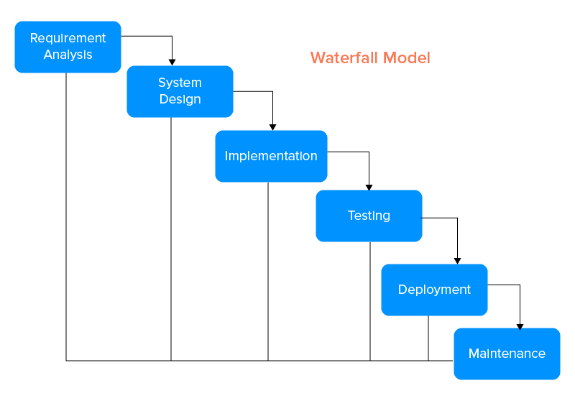
Waterfall Model

Slide 19
Waterfall Model
The waterfall Model is a linear sequential flow.
In which progress is seen as flowing steadily downwards (like a waterfall) through the phases of software implementation.
This means that any phase in the development process begins only if the previous phase is complete.

Slide 20
Waterfall model
The waterfall approach does not define the process to go back to the previous phase to handle changes in requirement.
The waterfall approach is the earliest approach and most widely known that was used for software development.

Slide 21
Waterfall Advantages
Easy to understand, easy to use
Provides structure to inexperienced staff
Milestones are well understood
Sets requirements stability
Suited for smaller projects where requirements are well defined

Slide 22
Waterfall Disadvantages
All requirements must be known upfront
Deliverables created for each phase are considered frozen – inhibits flexibility
Does not reflect problem-solving nature of software development – iterations of phases
Error can be fixed only during the phase
Little opportunity for customer to preview the system (until it may be too late)

Slide 23
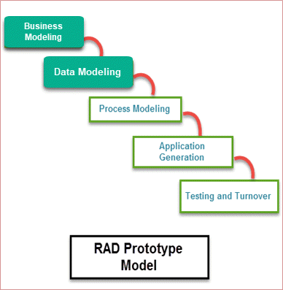
Prototyping and rapid application development model

Slide 24
Rapid application development (RAD) describes a method of software development which heavily emphasizes rapid prototyping and iterative delivery.
The RAD model is, therefore, a sharp alternative to the typical waterfall development model, which often focuses largely on planning and sequential design practices

Slide 25
When to use RAD Methodology?
When a system needs to be produced in a short span of time (2-3 months)
When the requirements are known
When the user will be involved all through the life cycle
When budget is high enough to afford designers for modelling along with the cost of automated tools for code generation

Slide 26
RAD Advantages
Flexible and adaptable to changes
Due to prototyping in nature, there is a possibility of lesser defects
With less people, productivity can be increased in short time

Slide 27
RAD Disadvantages
It can't be used for smaller projects
Not all application is compatible with RAD
If developers are not committed to delivering software on time, RAD projects can fail
Requires highly skilled designers or developers

Slide 28
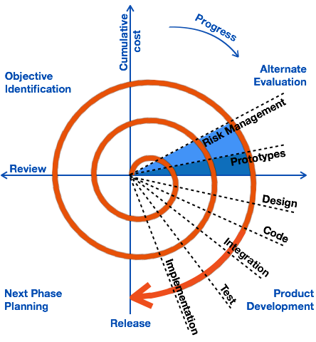
Spiral or Iterative model.

Slide 29
Spiral or Iterative model
The spiral model emphasis placed on risk analysis.
The spiral model has four phases: Planning, Risk Analysis, Engineering and Evaluation.
A software project repeatedly passes through these phases in iterations (called Spirals in this model).
The baseline spiral, starting in the planning phase, requirements are gathered and risk is assessed.

Slide 30
Spiral Model Advantages
Provides early indication of risks, without much cost
Users see the system early because of rapid prototyping tools
Users can be closely tied to all lifecycle steps
Early and frequent feedback from users

Slide 31
Spiral Model Disadvantages
Time spent for evaluating risks too large for small or low-risk projects
The model is complex
Risk assessment expertise is required
Spiral may continue indefinitely
Developers must be reassigned during non-development phase activities

Slide 32
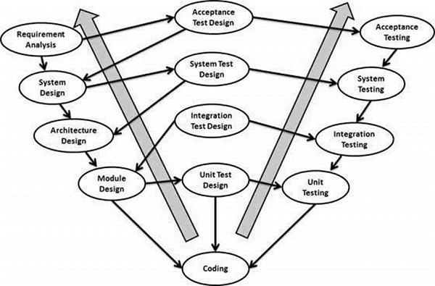
V model

Slide 33
V Model
The V-model is an SDLC model where execution of processes happens in a sequential manner in a V-shape. It is also known as Verification and Validation model.
In V-Model every single phase in the development cycle, there is a directly associated testing phase.
This is a highly-disciplined model and the next phase starts only after completion of the previous phase.
Verification phases on one side of the ‘V’ and Validation phases on the other side. The Coding Phase joins the two sides of the V-Model.

Slide 34
V-Shaped Advantages
Emphasize planning for verification and validation of the product in early stages of product development
Each deliverable must be testable
Project management can track progress by milestones
Easy to use

Slide 35
V-Shaped Disadvantages
Not a good model for complex and object-oriented projects
Does not handle iterations or phases
Does not easily handle dynamic changes in requirements.
Once an application is in the testing stage, it is difficult to go back and change a functionality

Slide 36
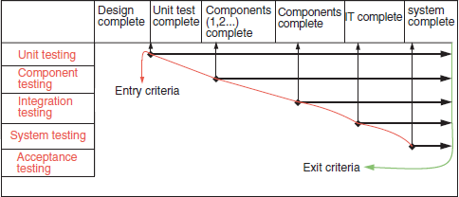
Modified V model

Slide 37
Modified v model
As the v model focuses on types of testing similarly modified v model focuses on phases of testing.
A phase of testing is a one to one mapping to the type of testing.Eg :unit testing phase, component testing phase.
Once the unit has completed its unit testing phase it becomes the part of component and moves on to component testing phase.
Here the different phases are done in parallel.
Here entry and exit criteria for each of the phase ensure that right quality of product delivered for starting the test and right amount of testing is completed for the release.

Slide 38
White Box testing
White Box Testing is a software testing method in which the internal structure/design/implementation of the item being tested is known to the tester
White Box Testing also known as Clear Box Testing, Open Box Testing, Glass Box Testing, Transparent Box Testing, Code-Based Testing or Structural Testing

Slide 39
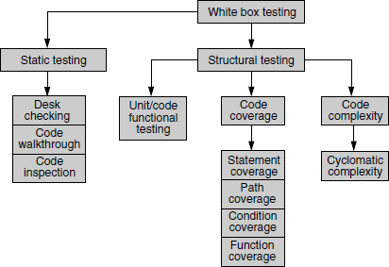
Classification of white box testing

Slide 40
White box testing is classified into
1.Static Testing
2.Structural Testing
1.Static Testing
Static testing is a type of testing which requires only the source code of the product, not the binaries or executables.
There are multiple methods to achieve static testing
Static Testing by humans.
Desk checking of the code
Code walkthrough
Code inspection

Slide 41
2.Structural Testing
Structural testing takes into account the code, code structure, internal design, and how they are coded.
There are multiple methods to achieve static testing
Unit/Code Functional Testing
Code Coverage Testing
Code Complexity Testing

Slide 42
CHALLENGES IN WHITE BOX TESTING
Human tendency of a developer being unable to find the defects in his or her code.
Fully tested code may not correspond to realistic scenarios.

Slide 43
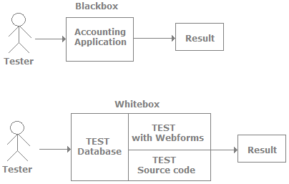

Slide 44
Black box testing
Black box testing involves looking at the specifications and does not require examining the code of a program.
Black box testing is done from the customer's viewpoint.
The test engineer engaged in black box testing only knows the set of inputs and expected outputs.
It is unaware of how the inputs are transformed into outputs by the software i.e Black box testing is done without the knowledge of the internals of the system under test.
Black box testing requires a functional knowledge of the product to be tested.

Slide 45

Black box testing (Lock and key)example

Slide 46
Black box testing (Lock and key)example
Functionality | What you need to know to use
Features of a lock | It is made of metal, has a hole provision to lock, has a facility to insert the key, and the keyhole ability to turn clockwise or anticlockwise.
Features of a key | It is made of metal and created to fit into a particular lock's keyhole.
Actions performed | Key inserted and turned clockwise to lock Key inserted and turned anticlockwise to unlock

Slide 47
Black box testing (Lock and key)example
States Inputs Expected outcome | Locked Unlocked Key turned clockwise or anticlockwise Expected outcome Locking Unlocking

Slide 48
WHY BLACK BOX TESTING
Black box testing helps in the overall functionality verification of the system under test.
Black box testing is done based on requirements.
Black box testing addresses the stated requirements as well as implied requirements.
Black box testing encompasses the end user perspectives.
Black box testing handles valid and invalid inputs.

Slide 49
WHEN TO DO BLACK BOX TESTING?
Black box testing activities require involvement of the testing team from the beginning of the software project life cycle.
Testers can get involved right from the requirements gathering and analysis phase for the system under test.
Test scenarios and test data are prepared during the test construction phase of the test life cycle, when the software is in the design phase.
Once the code is ready and delivered for testing, test execution can be done.

Slide 50
Thank You

